Slide 1
Introduction to Electric Machines
DC Motors and Generators
M.V. Iordache, EEGR3523 Mechatronics, Spring 2020, LeTourneau University

Slide 2
Introduction
At this point of our class we begin the study of electric motors and generators.
We will consider first DC machines.
In future lectures we will study also
AC machines
Stepper motors

Slide 3
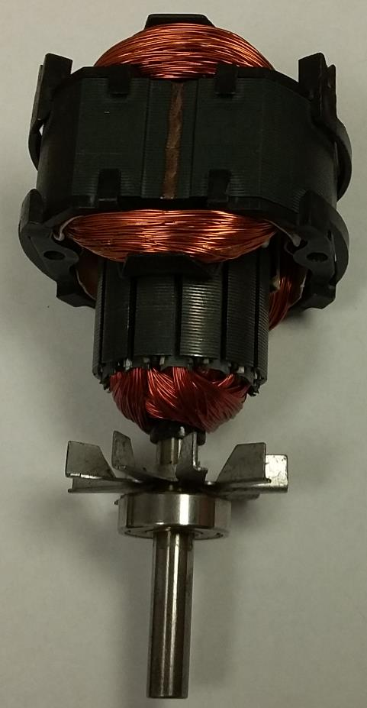
Electric Machine Components
The fixed part of the machine is called stator.
The rotating part is called rotor.
The stator and/or the rotor contain coils of wire
(electromagnets) producing a magnetic field when
an electric current flows through them.

Slide 4
Electric Machine Components
The armature is the main current-carrying component.
The armature current is alternating even for DC motors.
This distinguishes the armature from the electromagnets of
the field poles, if any, which have DC current.
The armature windings are the coils of the armature.
The field windings are the coils of the field poles.

Slide 5
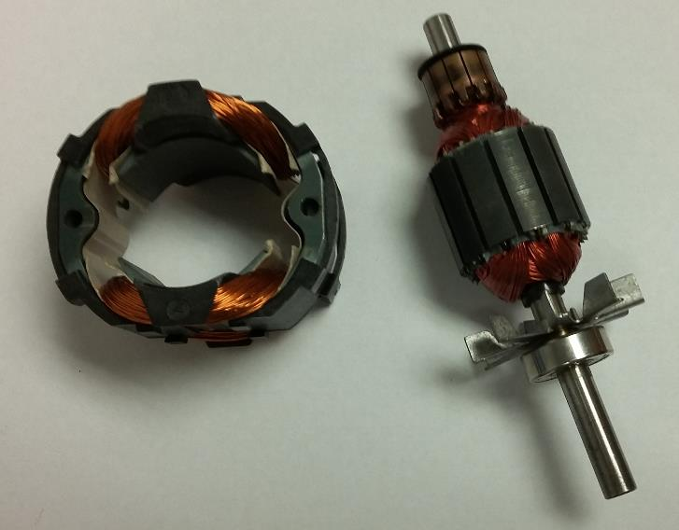
Electric Machine Components
In a DC motor, torque is created based on the interaction between the constant magnetic field of the field poles and the (alternating) magnetic field of the armature.
Commonly, the field poles are on the stator and the armature is the rotor.
Stator with two field poles
The rotor of this motor is the armature
Pole face

Slide 6
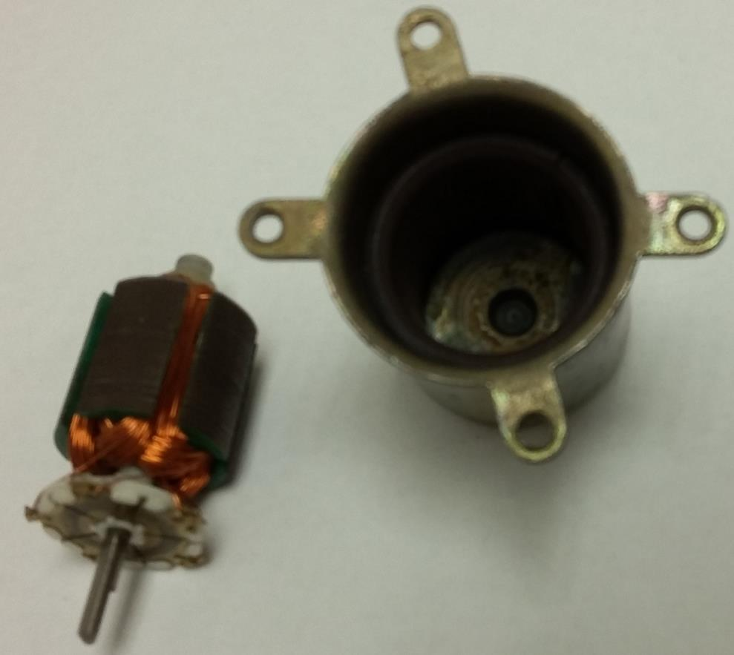
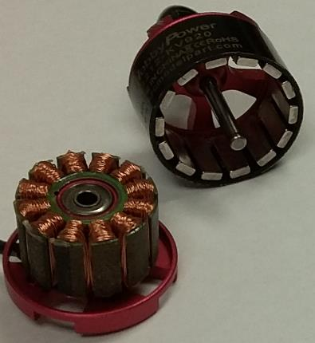
Electric Machine Components
Field poles can be made with permanent magnets instead of electromagnets.
Commonly the field poles are on the stator and the armature is the rotor.
Sometimes the armature is the stator and the field poles are on the rotor.
The stator has 2 permanent magnet poles
Rotor with 14 permanent magnet poles
The rotor is the armature
For this motor, the stator is the armature

Slide 7
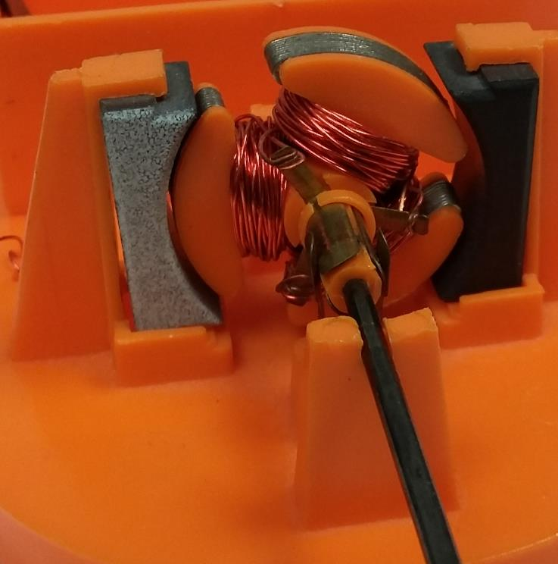
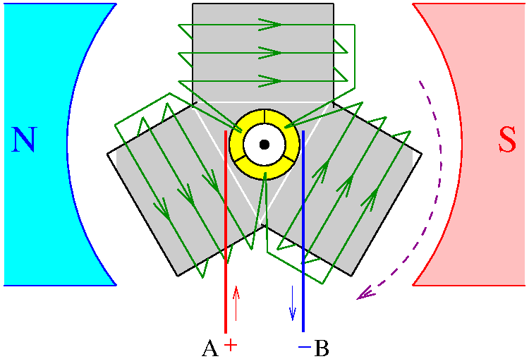
Electric Machine Components
One of the simplest DC machines has 3 poles on the rotor (armature) and 2 permanent magnet stator poles.
Stator
Stator
pole
Stator
pole
Rotor

Slide 8
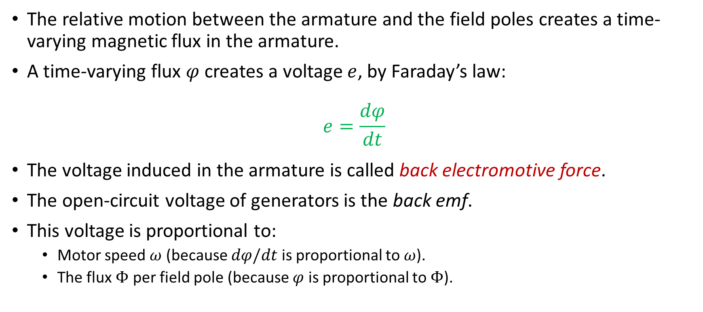
Electric Machine Principle
The relative motion between the armature and the field poles creates a time-varying magnetic flux in the armature.
A time-varying flux $φ$ creates a voltage $e$, by Faraday’s law:
$$e=\frac{dφ}{dt}$$
The voltage induced in the armature is called back electromotive force.
The open-circuit voltage of generators is the back emf.
This voltage is proportional to:
Motor speed $ω$ (because $dφ/dt$ is proportional to $ω$).
The flux $Φ$ per field pole (because $φ$ is proportional to $Φ$).

Slide 9

Electric Machine Principle
The interaction between the magnetic fields of the field poles and the armature poles creates torque.
Torque is proportional to:
The armature current.
The flux $Φ$ per field pole.

Slide 10
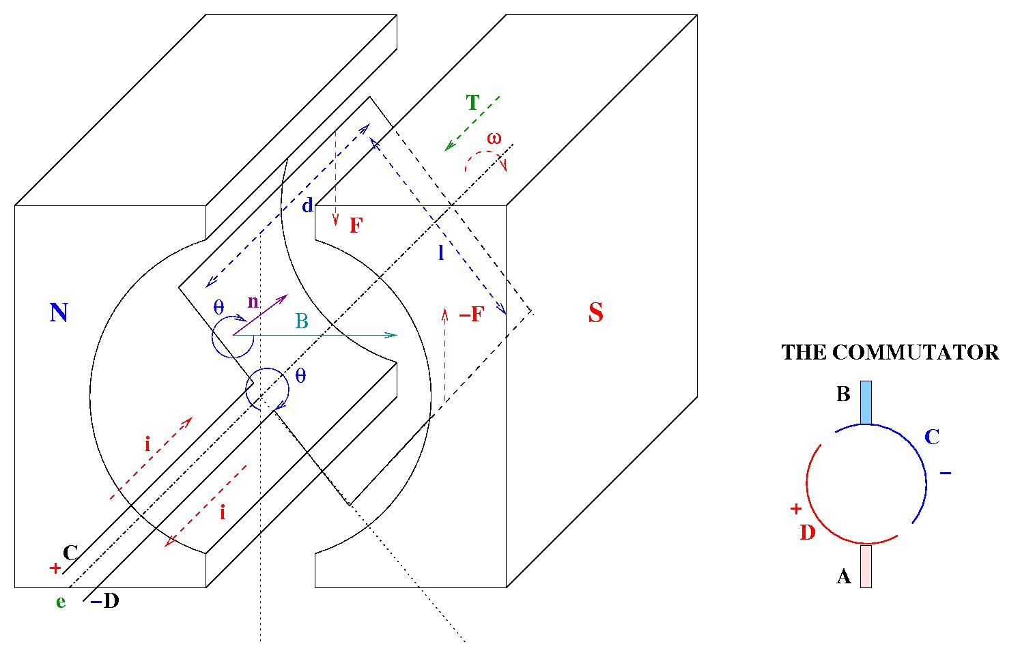
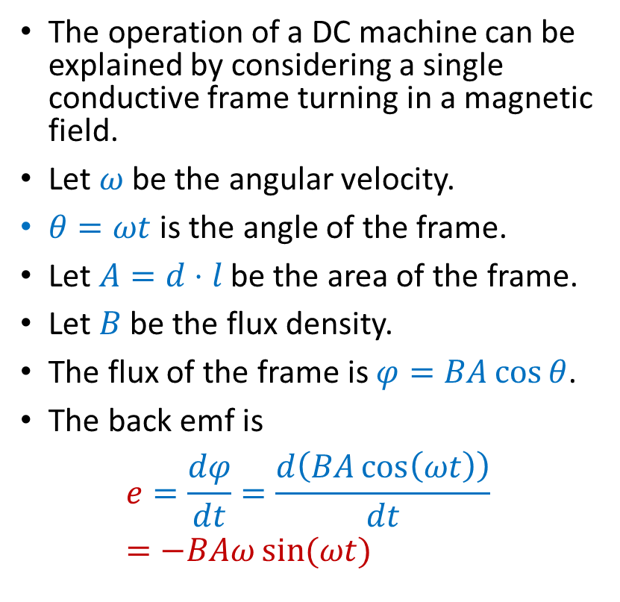
Electric Machine Principle
The operation of a DC machine can be explained by considering a single conductive frame turning in a magnetic field.
Let $ω$ be the angular velocity.
$θ=ωt$ is the angle of the frame.
Let $A=d⋅l$ be the area of the frame.
Let $B$ be the flux density.
The flux of the frame is $φ=BA\cos{θ}$.
The back emf is
$$e=\frac{dφ}{dt}=\frac{d\left(BA\cos\left(ωt\right)\right)}{dt}=−BAω\sin{(ωt)}$$

Slide 11
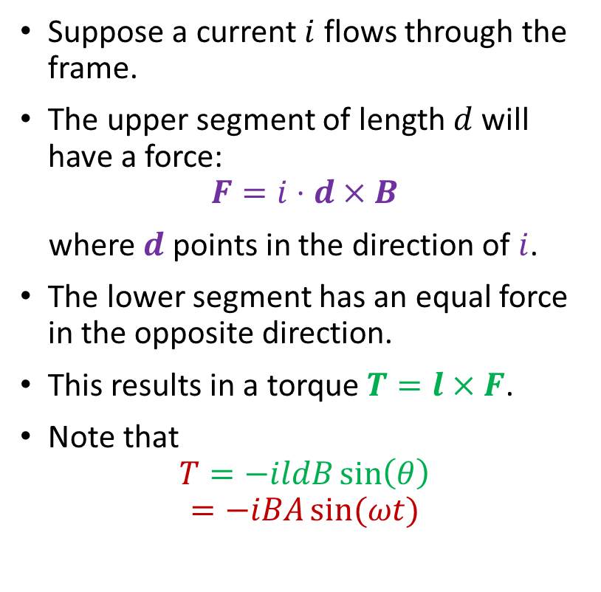
Electric Machine Principle
Suppose a current $i$ flows through the frame.
The upper segment of length $d$ will have a force:
$$F=i⋅d×B$$
where $d$ points in the direction of $i$.
The lower segment has an equal force in the opposite direction.
This results in a torque $T=l×F$.
Note that
$$T=−ildB\sin\left(θ\right)$$
$$=−iBA\sin{(ωt)}$$

Slide 12
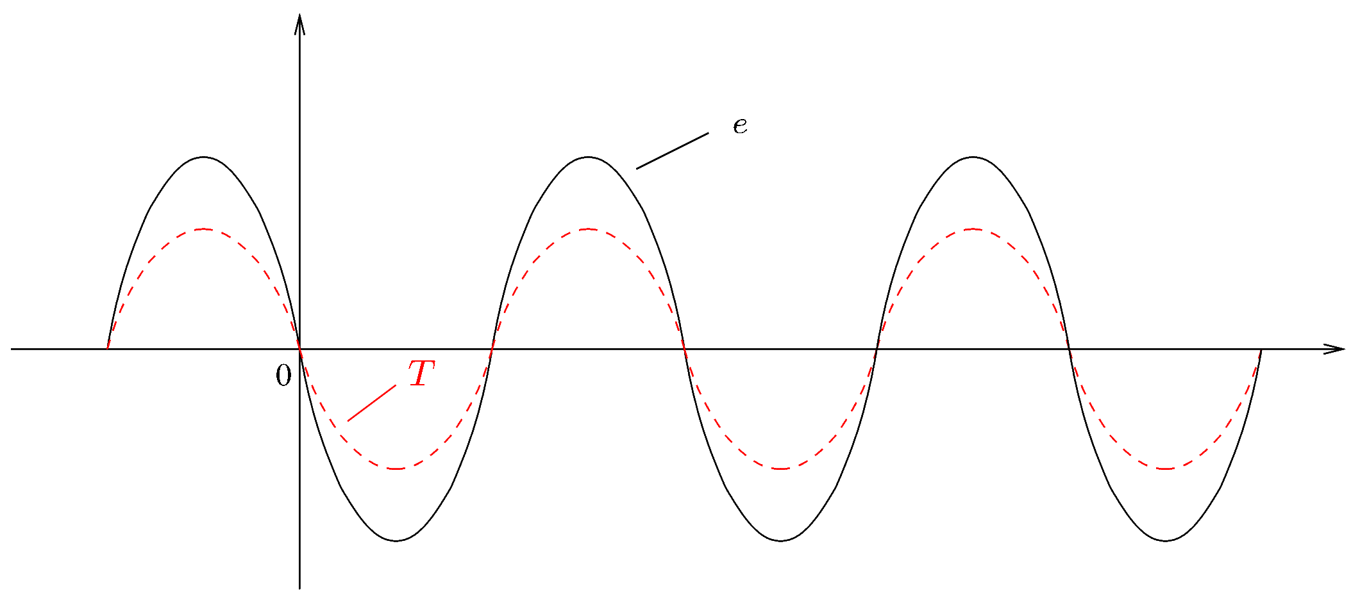

Electric Machine Principle
We have shown that $e=−BAω\sin{(ωt)}$ and $T=−iBA\sin{(ωt)}$.
Unless $i$ is time varying, the torque is a zero-mean sinusoidal function of time!
To achieve a non-zero average torque, we need a time-varying armature current.
Notes:
presm/tplot.fig

Slide 13
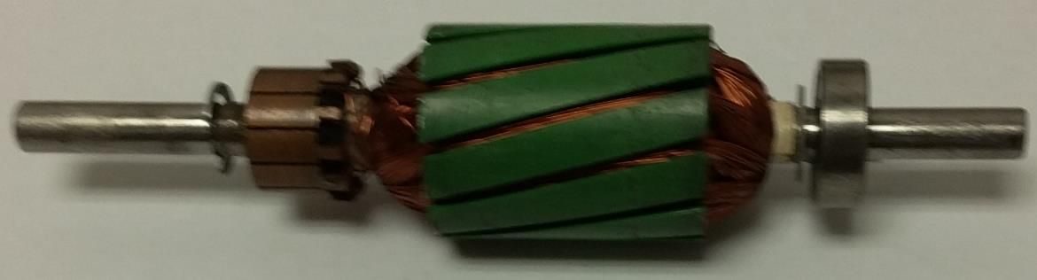
Electric Machine Principle
The simplest way to ensure a time-varying armature current is by means of mechanical commutation.
As the motor shaft rotates, the polarity of the voltage applied to the armature coils is switched mechanically.
This is done by means of a rotary switch called commutator.
The commutator is a cylinder attached rigidly to the motor shaft.
It has parallel contact segments.
A number of fixed contacts, called brushes, touch the commutator.
As the commutator rotates, the brushes touch different contact segments.

Slide 14
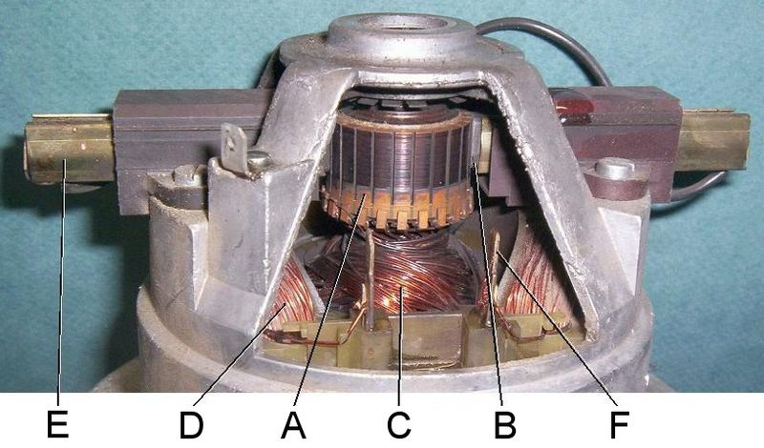
Electric Machine Principle
A commutator image from Wikipedia
(Universal_motor_commutator.jpg, in the public domain.
Retrieved on April 4, 2020, from https://en.wikipedia.org/wiki/Commutator_(electric) .)
Commutator in a universal motor from a vacuum cleaner. Parts:
Commutator
Brush
rotor (armature) windings
stator (field) windings
brush guides

Slide 15
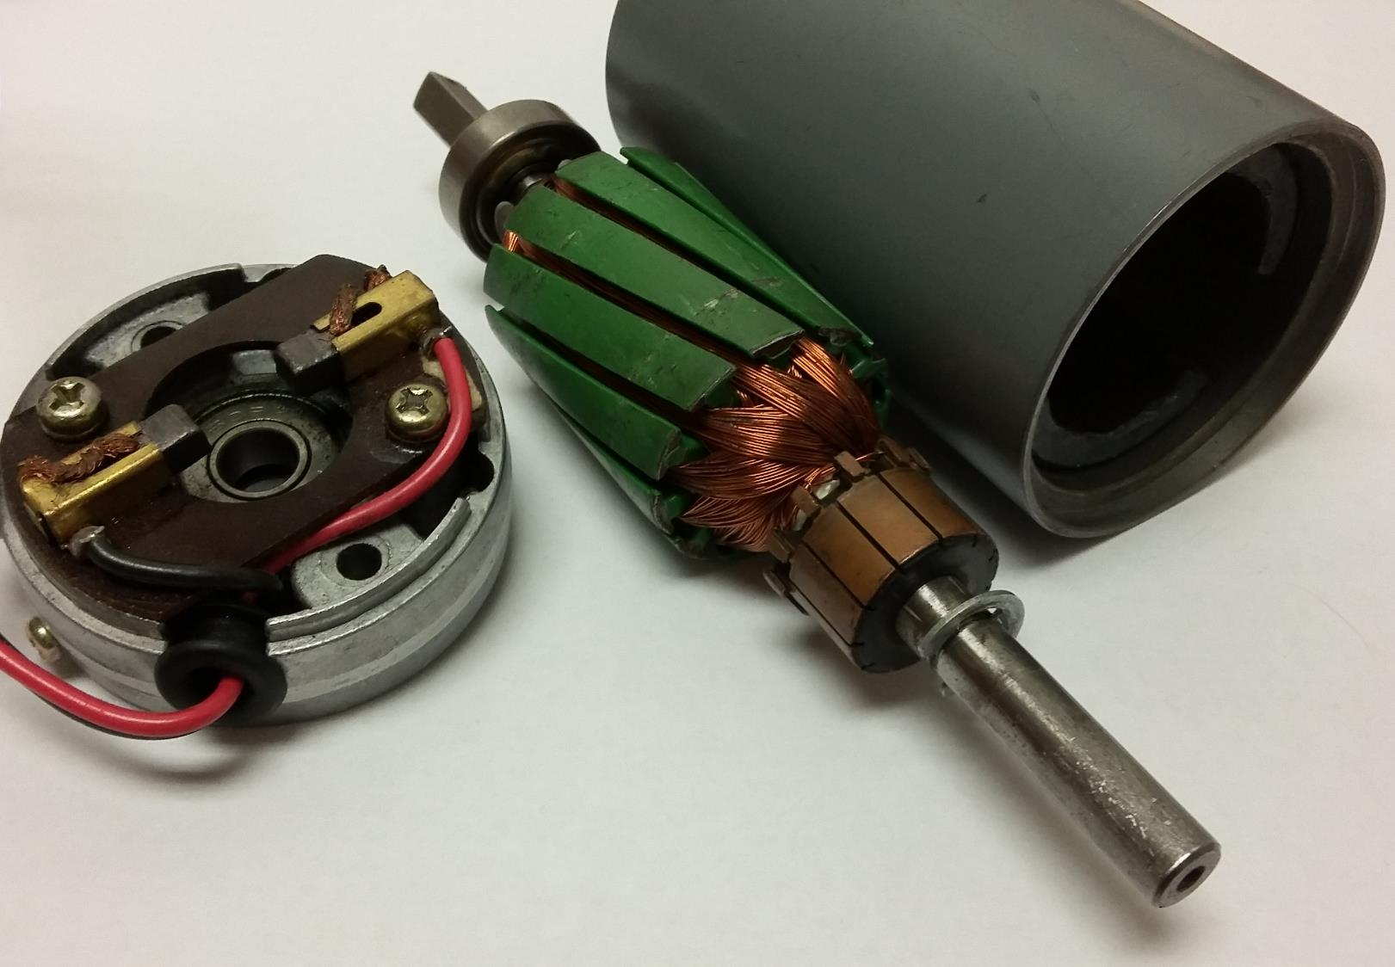
Electric Machine Principle
Rotor with 12 poles
Stator with two permanent magnet poles
Spring-loaded brushes
Commutator with 12 segments

Slide 16
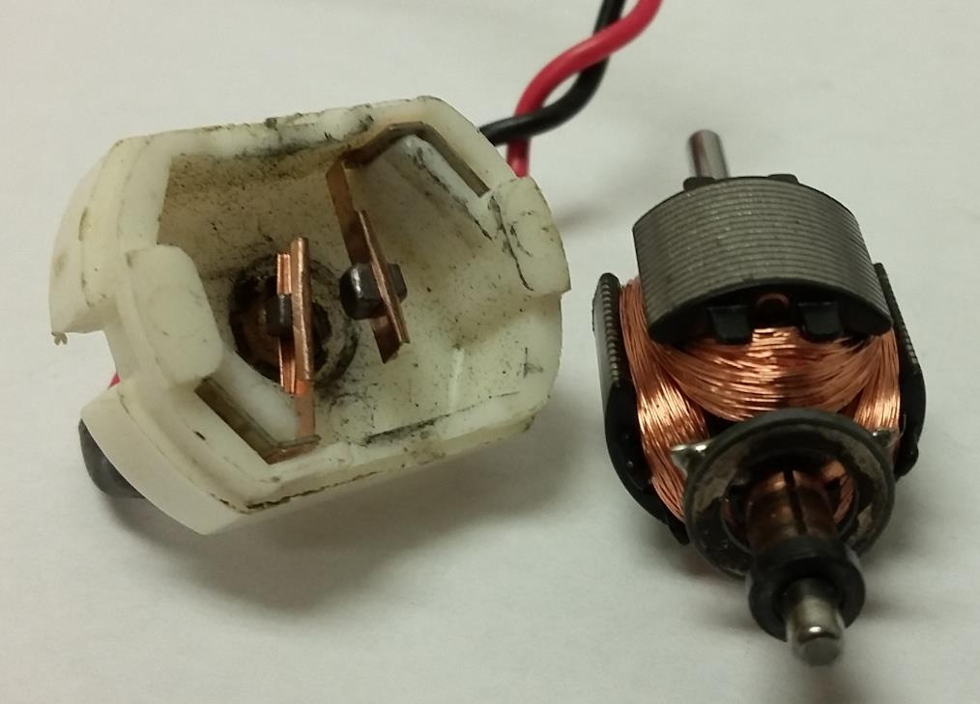
Electric Machine Principle
The figure at the right shows the two brushes and the three commutator segments of a machine with three poles on the armature.
Commutator segments
Commutator
Brushes
Brush
Brush

Slide 17
Electric Machine Principle
A commutator could be added to the rotating frame considered earlier.
Instead of powering the machine at C and D, we power it at the brushes A and B.
The brushes touch periodically the contact segments connected to C and D.
In this way, the direction of the current is switched so that the torque does not change sign.

Slide 18
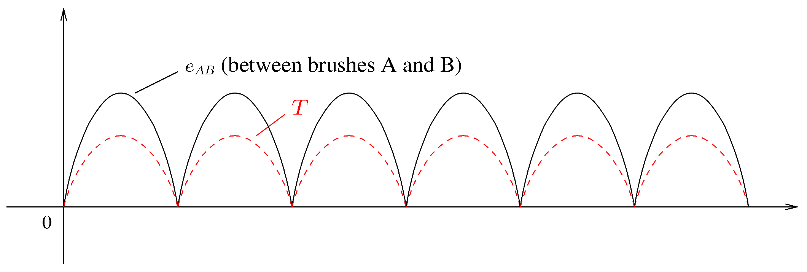
Electric Machine Principle
With a commutator, the torque has always the same sign.
When the machine is used as a generator, the generated voltage will not change sign.
The graphs were obtained for a very simple machine.
The torque and the back emf pulsate also for more complex machines, though not as much.

Slide 19
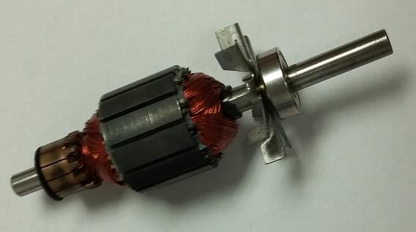
Electric Machine Principle
The torque and the back emf pulsate also for more complex machines, though not as much.
This issue can be reduced or eliminated with a skewed armature design.
skewed
not skewed

Slide 20
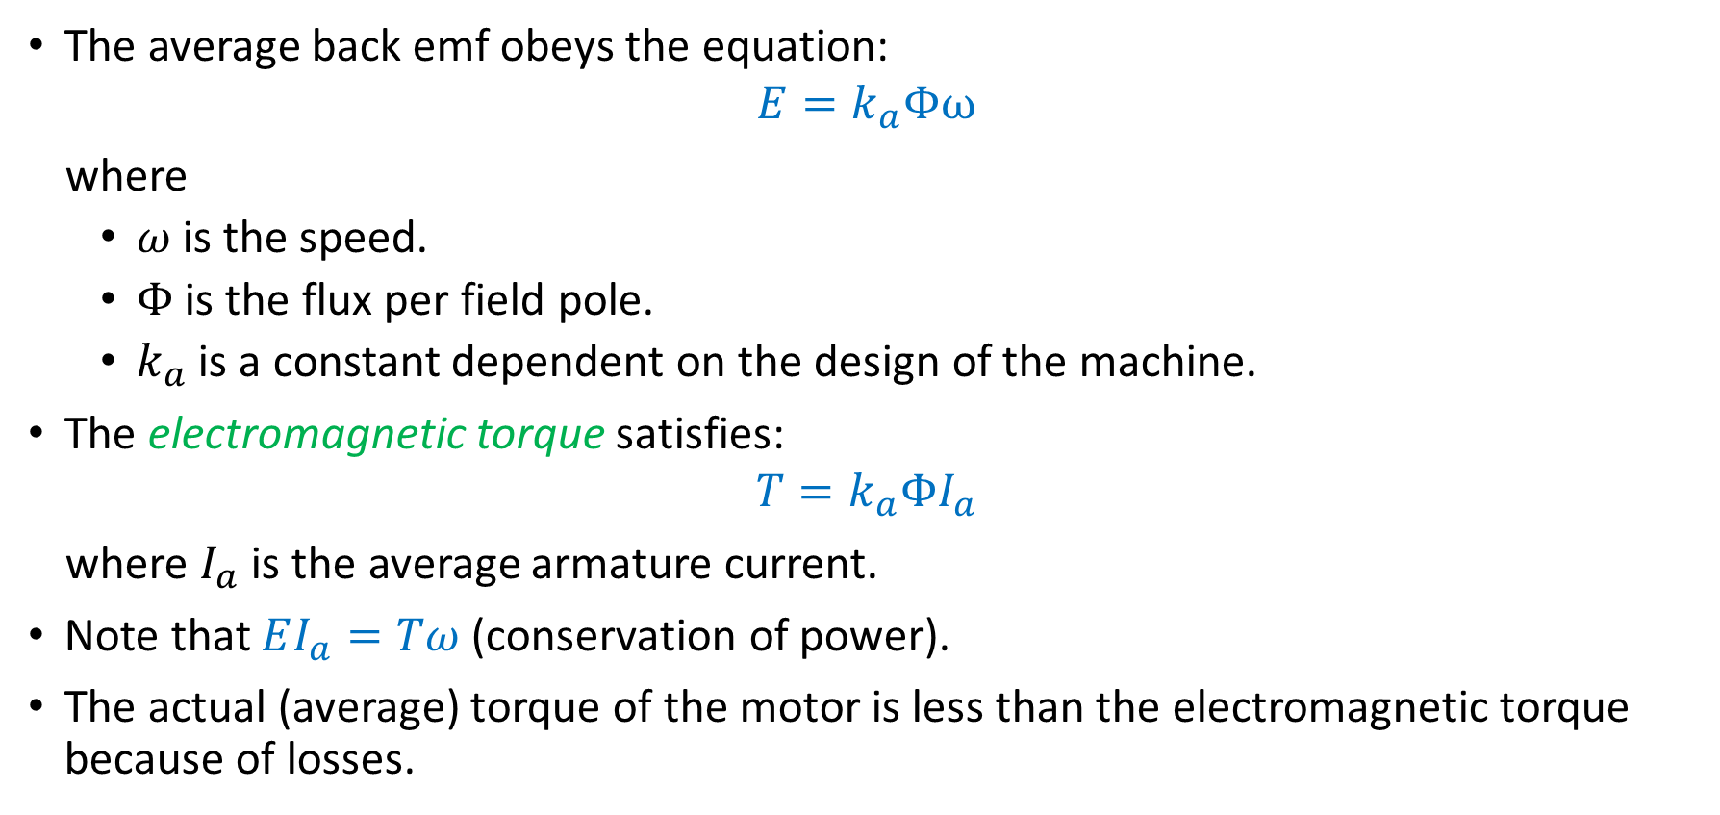
DC Machine Equations
The average back emf obeys the equation:
$$E=k_{a}Φω$$
where
$ω$ is the speed.
$Φ$ is the flux per field pole.
$k_{a}$ is a constant dependent on the design of the machine.
The electromagnetic torque satisfies:
$$T=k_{a}ΦI_{a}$$
where $I_{a}$ is the average armature current.
Note that $EI_{a}=Tω$ (conservation of power).
The actual (average) torque of the motor is less than the electromagnetic torque because of losses.

Slide 21
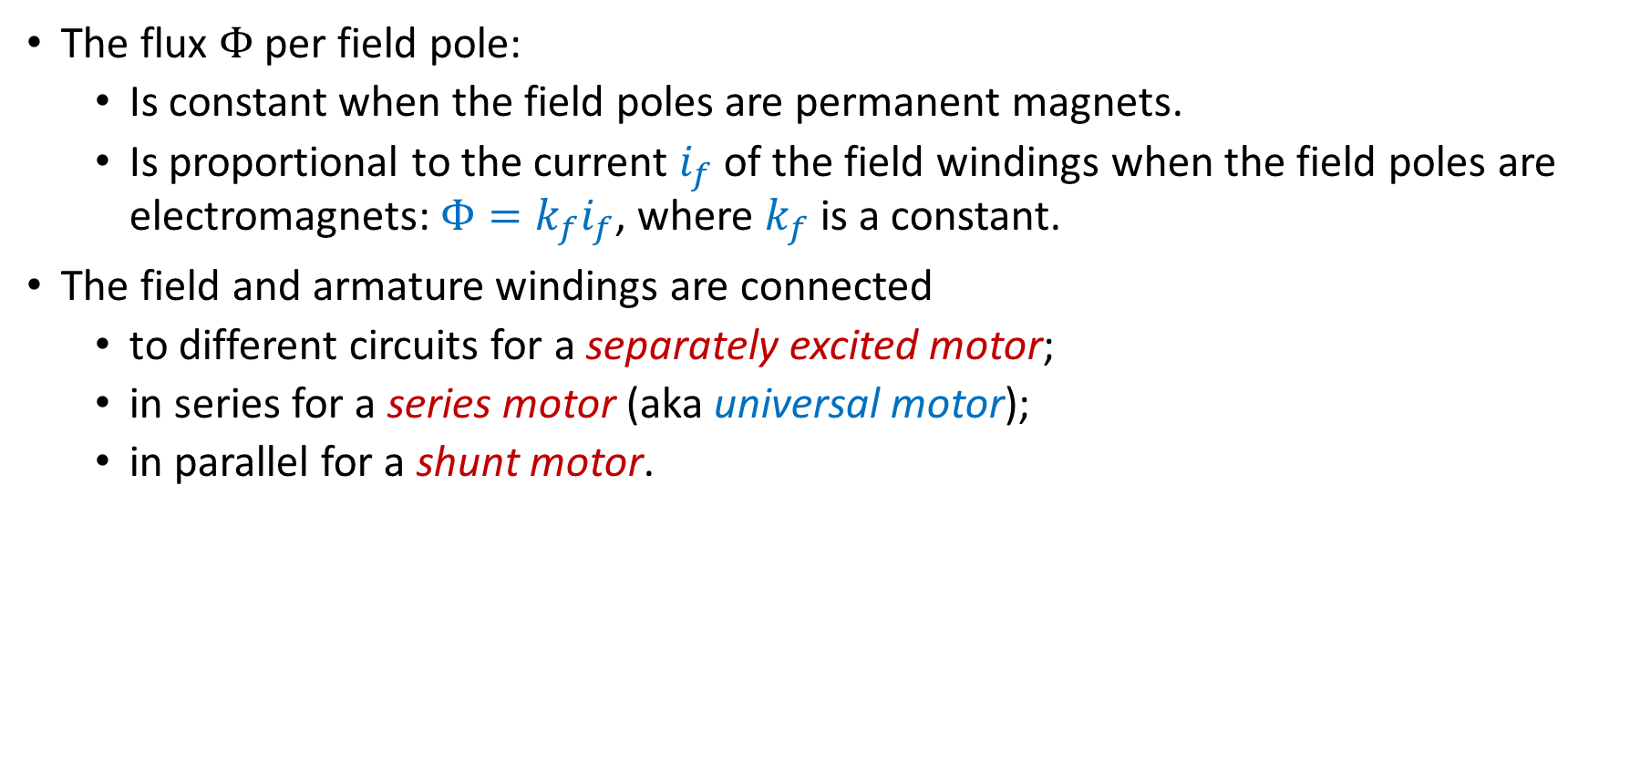
DC Machine Equations
The flux $Φ$ per field pole:
Is constant when the field poles are permanent magnets.
Is proportional to the current $i_{f}$ of the field windings when the field poles are electromagnets: $Φ=k_{f}i_{f}$, where $k_{f}$ is a constant.
The field and armature windings are connected
to different circuits for a separately excited motor;
in series for a series motor (aka universal motor);
in parallel for a shunt motor.

